Slide 1
Is this an Israeli invention?

Slide 2
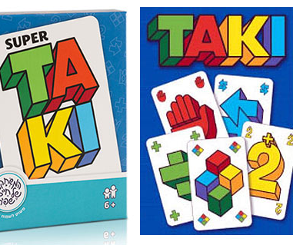
Is this an Israeli invention?

Slide 3
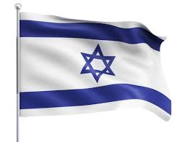
Yes!
Taki card game developed and published by Haim Shafir in 1983.
The name “Taki" means waterfall in Japanese, and the card bearing this name, allows the player to "spill" all the cards of the same color.

Slide 4
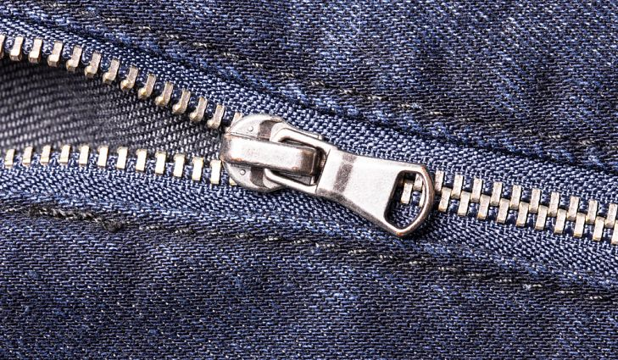
Is this an Israeli invention?

Slide 5
In 1851, Elias Howe, an American inventor, received a patent for an "Automatic, Continuous Clothing Closure".
No!
Zipper is not an Israeli invention!

Slide 6
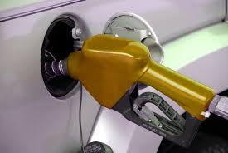
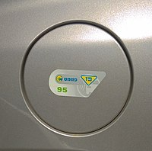
Is this an Israeli invention?
Dalkan device

Slide 7
Yes!
The idea for the Dalkan device was invented in 1983 by David Kelerich of the Israeli "Tadiran" company, and its development was completed by Kelerich in 1991 with Orpak Corporation .
Since then, it has been installed in millions of vehicles, in dozens of countries around the world.

Slide 8
Is this an Israeli invention?
TRX

Slide 9
No!
TRX is not an Israeli invention!
Randy Hetrick, a former Navy Seal, developed the Total Resistance eXercise (TRX) equipment in the 1990s.

Slide 10
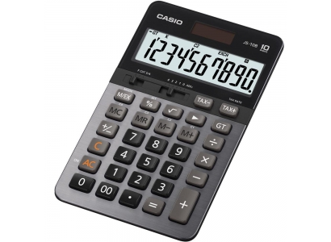
Is this an Israeli invention?

Slide 11
No!
Calculator is not an Israeli invention!
Willhelm Schickard, a German professor, invented the "Calculating Clock", the first mechanical calculator.

Slide 12
Is this an Israeli invention?

Slide 13
An early type of rudimentary gas mask was invented in the 9th century by the Persian Banu Musa brothers in Baghdad, Iraq.
They described it in their Book of Ingenious Devices, mainly for protecting workers in polluted wells.
No!
Gas mask is not an Israeli invention!

Slide 14
Is this an Israeli invention?

Slide 15
Yes!
Waze is an Israeli invention!
Waze started in 2006, as "FreeMap Israel", a project founded and developed by Israeli programmer Ehud Shabtai as a community project. In 2008, Shabtai formed a company called Waze to commercialize the project.

Slide 16
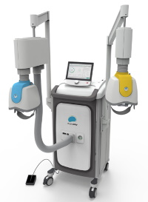
Is this an Israeli invention?
Deep TMS (Deep transcranial magnetic stimulation)
Notes:
2. קסדת Deep TMS – גריית מוח באמצעות סלילים אלקטרומגנטיים המייצרים שדות מגנטיים המשפיעים על קליפת המוח (Cortex) ומסייעים לטפל בהפרעות נפשיות כדיכאון, סכיזופרניה, אפילפסיה, מאניה-דיפרסיה ועוד. חברת בריינסווי.
עצבוב של נוירוטרנסמיטורים במח בצורה לא פולשנית לטיפול והטבה במחלות המוזכרות

Slide 17
Yes!
TMS is an Israeli invention!
A unique, noninvasive treatment process developed by BrainsWay that helps alleviate symptoms related to mental health conditions.
During the Deep TMS process, an electromagnetic field is activated by BrainsWay’s patented H-Coil technology, which is held inside a helmet apparatus fitted over the patient’s head. The helmet safely sends out magnetic pulses that are able to directly reach deeper, broader brain structures, successfully influencing their neural activity.

Slide 18
Is this an Israeli invention?

Slide 19
In 1890, Francis Robbins Upton, a former associate of Thomas Edison, invented and patented the very first automatic fire alarm.
No!
Fire alarm is not an Israeli invention!

Slide 20
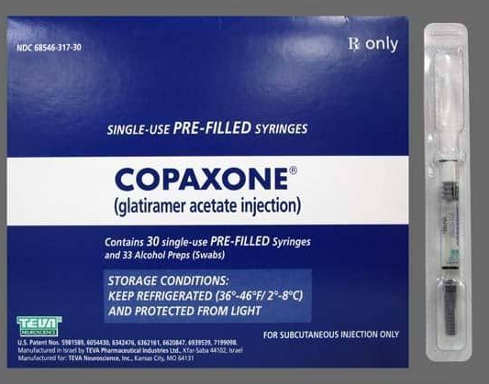
Is this an Israeli invention?

Slide 21
Yes!
Copaxone is an Israeli invention!
Copaxone immunomodulator drug for treating multiple sclerosis.
It was developed at the Weizmann Institute of Science in Israel by Michael Sela, Ruth Arnon, and Deborah Teitelbaum.
Notes:
תרופה לטרשת נפוצה
התרופה הפטנטית הראשונה של חברת טבע

Slide 22
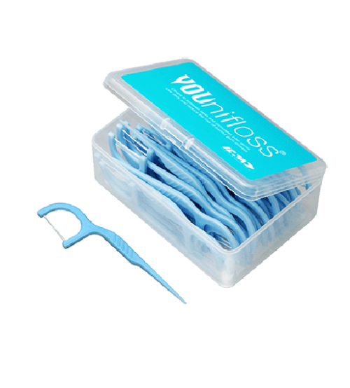
Is this an Israeli invention?

Slide 23
In 1819, Levi Spear Parmly, a dentist from New Orleans, is credited with inventing the first form of dental floss.
No!
Dental floss is not an Israeli invention!

Slide 24
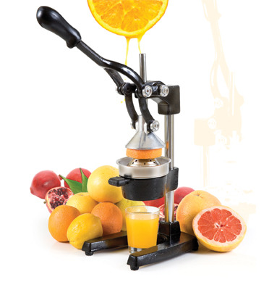
Is this an Israeli invention?

Slide 25
Yes!
Juicer is an Israeli invention!
Isaac Zaxenberg invented the first Hebrew Juicer, which has since also been known as the "Zeggenberg Juicer”. The long process of manufacturing included many models, and in 1931 the product was registered as a patent.

Slide 26
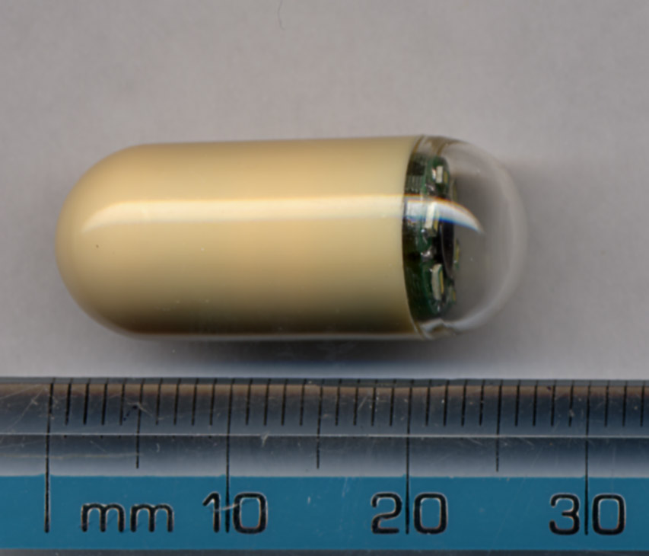
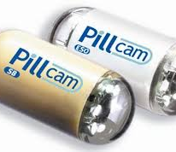
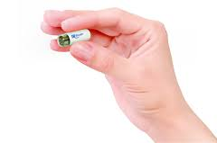
Is this an Israeli invention?

Slide 27
Yes!
The PillCam: Imaging Capsule for Endoscopy was conceived in 1998, following a chance conversation between Dr. Gavriel Iddan, an electro-optic engineer and rocket scientist at Rafael, and his gastroenterologist neighbor.

Slide 28
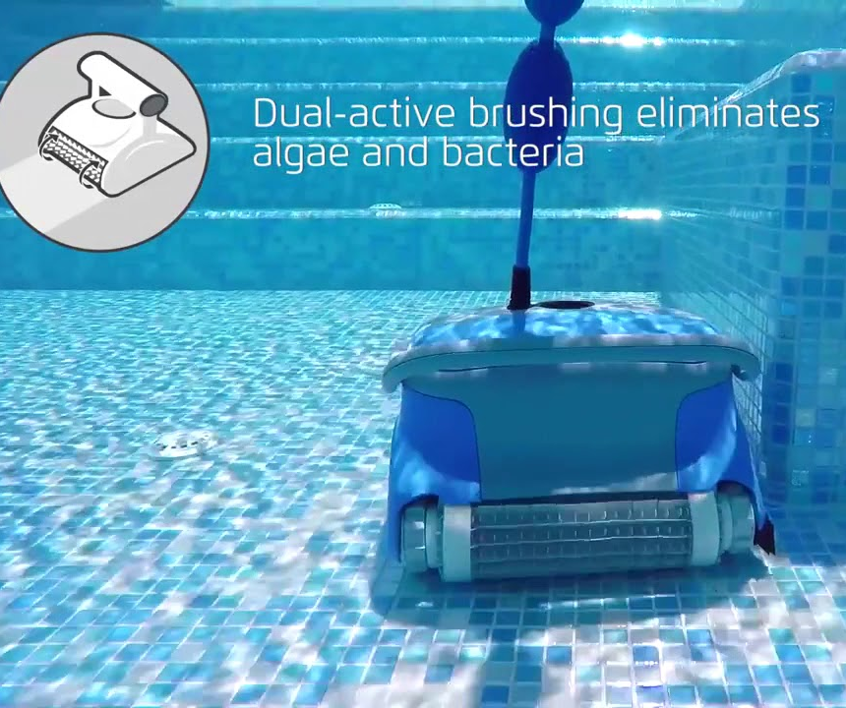
Is this an Israeli invention?
Robotic Swimming Pool Cleaner
Notes:
2.

Slide 29
Yes!
At 1983s, Maytronics factory in Kibbutz Yizre’el decided to begin focusing on developing a product that was, at the time, considered innovative: A Robotic Swimming Pool Cleaner, later named as “DOLPHIN”.

